Slide 1
Topic 2.2
Non-linear Data Structures

Slide 2

What is Non Linear Data Structure?
Non-linear data structures are those where data items are not arranged in a sequential manner, unlike linear data structures. In these data structures, elements are stored in a hierarchical or a network-based structure that does not follow a sequential order. These data structures allow efficient searching, insertion, and deletion of elements from the structure.
Examples of Non Linear Data Structures:
Trees
Graphs, etc.

Slide 3
Rooted trees
A rooted tree is a tree with a special vertex labelled as the "root" the of tree.
The root serves as a point of reference for other vertices in the tree. In diagrams, we usually keep the root at the top and list other vertices below it.
This notion is particularly useful in computer science for working with tree-based data structures.
In the figure, the root vertex is shown with a black border.
Below are some useful terms associated with rooted trees.
Branch is just another name given to edges of the tree.
Depth of a vertex is the number of branches in the path from root to the vertex. So depth of the root itself is zero.

Slide 4
Level of a vertex is number of vertex in the path from root to the vertex. This is just one more than the depth of the vertex. Level of root is 1.
Note: There can be multiple childs of a vertex, but parent of a vertex is unique. Root is the only vertex in a tree without any parent.
A leaf is a vertex without any child.
Height of tree is the maximum value of depth for any vertex in the tree.

Slide 5
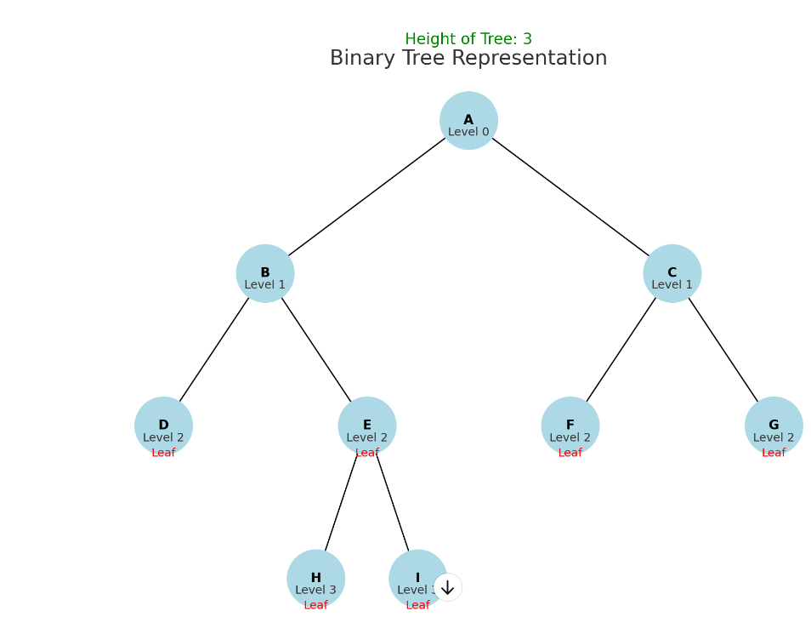

Slide 6
Binary Tree
A binary tree is a hierarchal data structure in which each node has at most two children. The child nodes are called the left child and the right child.
To start with, let’s describe the linked list representation of a binary tree in which each node has three fields:
Pointer to store the address of the left child
Data element
Pointer to store the address of the right child

Slide 7
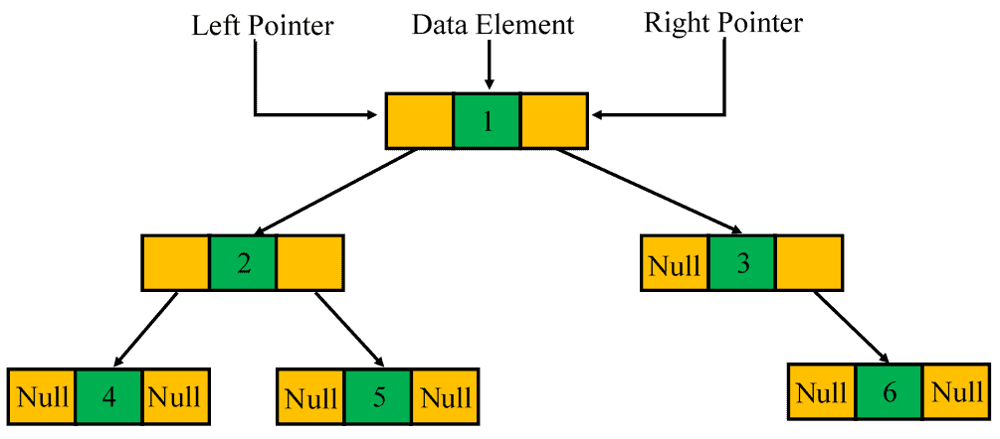

Slide 8
Properties
A binary tree can have a maximum of nodes at level if the level of the root is zero.
When each node of a binary tree has one or two children, the number of leaf nodes (nodes with no children) is one more than the number of nodes that have two children.
There exists a maximum of nodes in a binary tree if its height is , and the height of a leaf node is one.
If there are leaf nodes in a binary tree, then it has at least and at most levels.
A binary tree of nodes has minimum number of levels or minimum height.
The minimum and the maximum height of a binary tree having nodes are and , respectively.
A binary tree of nodes has null references.

Slide 9
How to implement a Binary Tree?
We’ll use an auxiliary Node class that will store int values. And keep a reference to each child:
class Node { int value; Node leftChild; Node rightChild; Node(int value) { this.value = value; rightChild = null; leftChild = null; } }

Slide 10
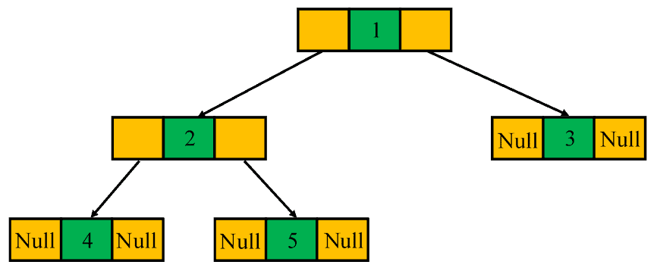
Types of Binary Trees
Full Binary Tree
A binary tree is said to be a full binary tree when each internal node has zero or two children:

Slide 11
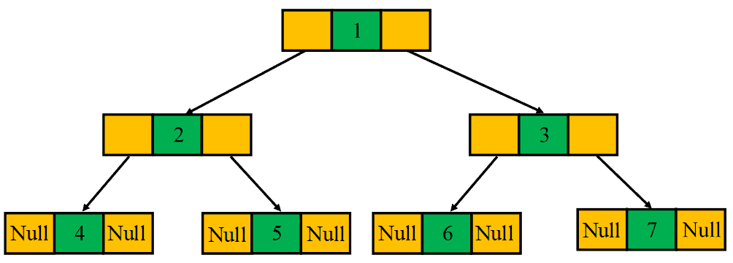
Perfect Binary Tree
A perfect binary tree is a special type of binary tree in which all the leaf nodes are at the same level, and each internal node has two children:

Slide 12
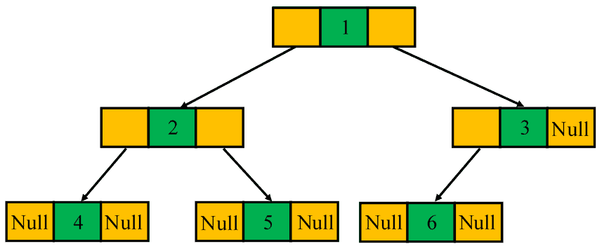
Complete Binary Tree
A binary tree is referred to as a complete binary tree when all of its levels are completely filled. The only exception is possibly the lowest level in which the nodes must lean as left as possible:

Slide 13
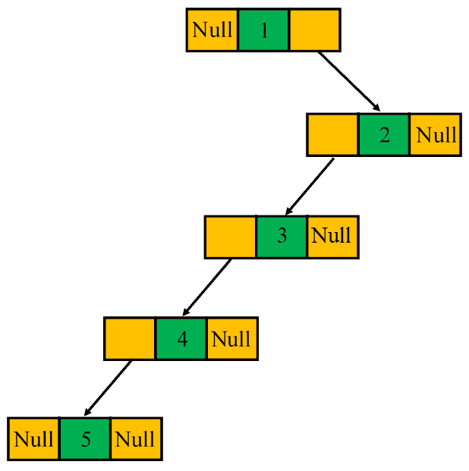
Degenerate or Pathological Tree
A degenerate or pathological tree is a type of binary tree in which each internal node has a single child, either the left child or the right child:

Slide 14
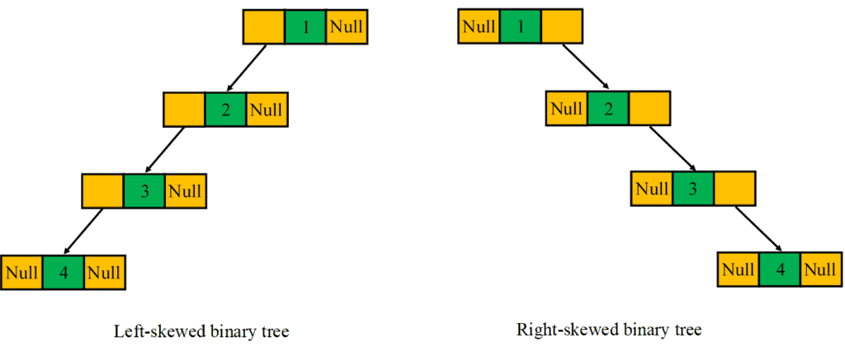
Skewed Binary Tree
A binary tree is said to be a skewed binary tree if all of its internal nodes have exactly one child, and either left children or right children dominate the tree. In particular, there exist two types of skewed binary trees: left-skewed binary tree and the right-skewed binary tree:

Slide 15
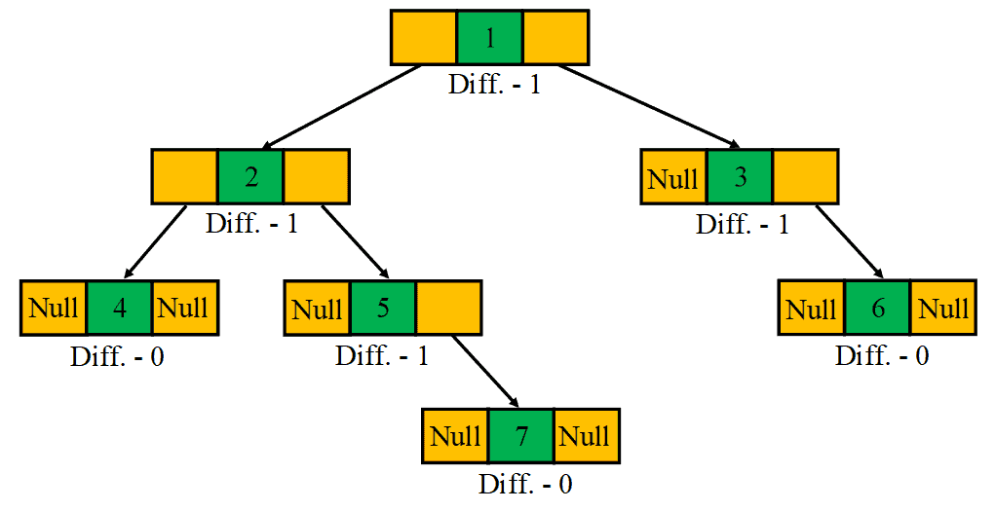
Balanced Binary Tree
A balanced binary tree is also a special type of binary tree in which the difference of height between the left and the right subtrees for each node is at most one:

Slide 16
Binary Search Tree
Binary search tree, also known as an ordered or sorted binary tree in computer science, is a rooted binary tree data structure in which each internal node stores a key that is larger than all keys in the node’s left subtree but less than those in the node’s right subtree.
What is the difference between a Binary tree and a Binary Search Tree?
A Binary Tree is a simple structure with the simple constraint that no parent can have more than two offspring, but a Binary Search Tree is a version of the binary tree that follows a certain order in which the nodes should be ordered.

Slide 17
It is called a binary tree because each tree node has a maximum of two children.
It is called a search tree because it can be used to search for the presence of a number in O(log(n)) time.
The properties that separate a binary search tree from a regular binary tree is
All nodes of left subtree are less than the root node
All nodes of right subtree are more than the root node
Both subtrees of each node are also BSTs i.e. they have the above two properties

Slide 18
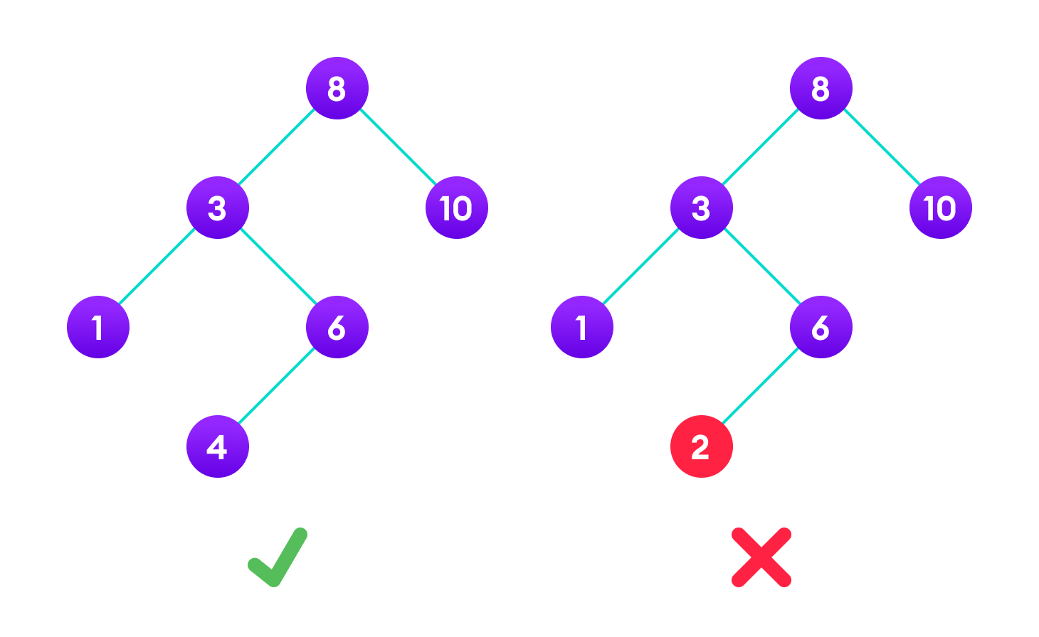

Slide 19
Search Operation
Algorithm:
If root == NULL return NULL; If number == root->data return root->data; If number < root->data return search(root->left) If number > root->data return search(root->right)

Slide 20
Insert Operation
Algorithm:
If node == NULL return createNode(data) if (data < node->data) node->left = insert(node->left, data); else if (data > node->data) node->right = insert(node->right, data); return node;

Slide 21
Deletion Operation
Case I
In the first case, the node to be deleted is the leaf node. In such a case, simply delete the node from the tree.
Case II
In the second case, the node to be deleted lies has a single child node. In such a case follow the steps below:
Replace that node with its child node.
Remove the child node from its original position.

Slide 22
Case III
In the third case, the node to be deleted has two children. In such a case follow the steps below:
Get the inorder successor of that node.
Replace the node with the inorder successor.
Remove the inorder successor from its original position.

Slide 23
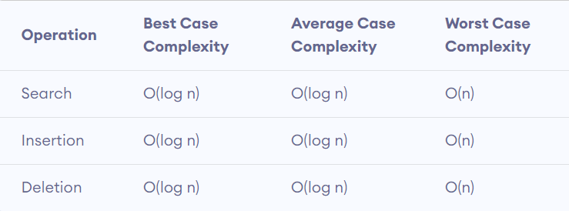
Binary Search Tree Complexities
Time Complexity

Slide 24
Here, n is the number of nodes in the tree.
Space Complexity
The space complexity for all the operations is O(n)

Slide 25
Traversal of trees
1. Depth First Search Traversal
It is a traversal algorithm in which, starting from the Root, it explores all nodes along each branch as deeply as possible until we get to a leaf node and then return to the “trunk” of the tree (backtracking).

Slide 26
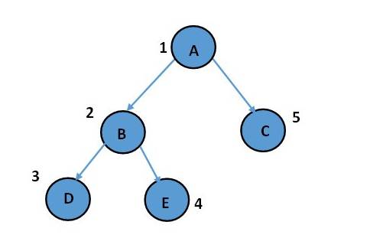
Since the stack follows the “LIFO” (Last In First Out) or “FILO” (First In Last Out) principle, i.e., whatever comes first in the stack, is the last item to be removed from the stack. So, a stack is used to implement depth-first search traversal. Depth First Search Traversal is further categorized into three popular tree traversals- Inorder Traversal, Preorder Traversal, and Postorder Traversal.

Slide 27
In-order Traversal
If a binary tree is traversed in-order, the output will produce sorted key values in an ascending order.
Step 1 − Recursively traverse left subtree.
Step 2 − Visit root node.
Step 3 − Recursively traverse right subtree.

Slide 28
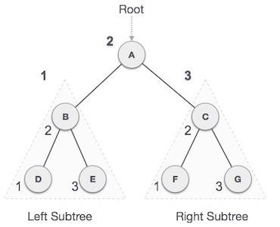
D → B → E → A → F → C → G

Slide 29
Pre-order Traversal
In this traversal method, the root node is visited first, then the left subtree and finally the right subtree.
Step 1 − Visit root node.
Step 2 − Recursively traverse left subtree.
Step 3 − Recursively traverse right subtree.

Slide 30
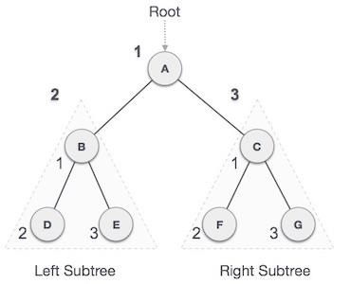
A → B → D → E → C → F → G

Slide 31
Post-order Traversal
In this traversal method, the root node is visited last, hence the name. First we traverse the left subtree, then the right subtree and finally the root node.
Step 1 − Recursively traverse left subtree.
Step 2 − Recursively traverse right subtree. Step 3 − Visit root node.

Slide 32
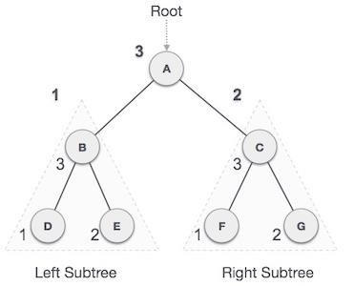
D → E → B → F → G → C → A

Slide 33
2. Breadth First Search Traversal (Level Order Traversal)
It is a traversal algorithm in which, starting from Root, it visits all nodes of the current level from left to right before moving to the next level in the tree. Since the queue follows First-In-First-Out (FIFO) principle, i.e., whatever comes first, is the first item to be removed from the queue. So, a queue is used to implement Breadth First Search/ Level Order Traversal.

Slide 34
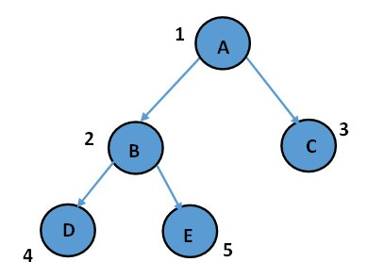
Level order traversal: A B C D E
Add the root node to the queue.
Iterate while the queue is not empty and print the value of the first node in the queue.
Add the left child of a node to the queue (if it exists).
Add the right child of a node to the queue (if it exists).

Slide 35
Balanced search trees
A binary tree is balanced if the height of the tree is O(Log n) where n is the number of nodes. For Example, the AVL tree maintains O(Log n) height by making sure that the difference between the heights of the left and right subtrees is at most 1.
Red-Black trees maintain O(Log n) height by making sure that the number of Black nodes on every root-to-leaf path is the same and that there are no adjacent red nodes.
Balanced Binary Search trees are performance-wise good as they provide O(log n) time for search, insert and delete.

Slide 36
A balanced binary tree is a binary tree that follows the 3 conditions:
The height of the left and right tree for any node does not differ by more than 1.
The left subtree of that node is also balanced.
The right subtree of that node is also balanced.
A single node is always balanced. It is also referred to as a height-balanced binary tree.

Slide 37
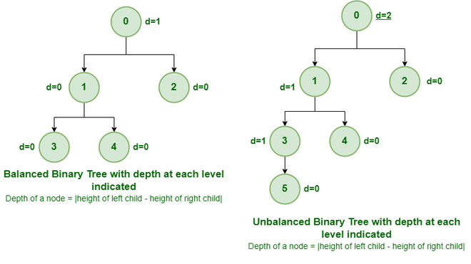

Slide 38
It is a type of binary tree in which the difference between the height of the left and the right subtree for each node is either 0 or 1. In the figure above, the root node having a value 0 is unbalanced with a depth of 2 units. Advantages of Balanced Binary Tree:
Non Destructive updates are supported by a Balanced Binary Tree with the same asymptotic effectiveness.
Range queries and iteration in the right sequence are made feasible by the balanced binary tree.

Slide 39
B-Tree
Properties of B-Tree:
All leaves are at the same level.
B-Tree is defined by the term minimum degree ‘t‘. The value of ‘t‘ depends upon disk block size.
Every node except the root must contain at least t-1 keys. The root may contain a minimum of 1 key.
All nodes (including root) may contain at most (2*t – 1) keys.
Number of children of a node is equal to the number of keys in it plus 1.
All keys of a node are sorted in increasing order. The child between two keys k1 and k2 contains all keys in the range from k1 and k2.
B-Tree grows and shrinks from the root which is unlike Binary Search Tree. Binary Search Trees grow downward and also shrink from downward.
Like other balanced Binary Search Trees, the time complexity to search, insert, and delete is O(log n).
Insertion of a Node in B-Tree happens only at Leaf Node.

Slide 40
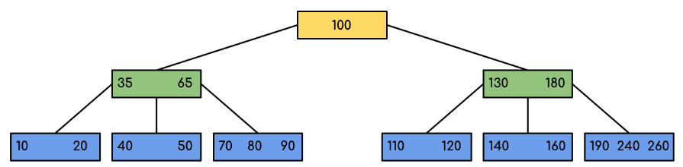
Following is an example of a B-Tree of minimum order 5 .

Slide 41
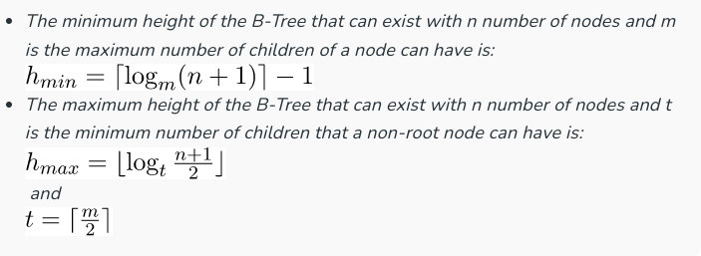

Slide 42
Heap Sort
Heap is a complete binary tree data structure with the property that the value of a parent node is either greater than or equal to (max heap) or less than or equal to (min-heap) the values of its children.
Heaps are used for efficient algorithms in sorting, selection, and as a priority queue.
Heap sort is a comparison-based sorting algorithm that sorts an array by creating a binary heap data structure. It has an average and worst-case time complexity of O(n log n)

Slide 43
What is Heap Sort in Data Structure?
Heap sort is a comparison-based sorting algorithm that sorts an array in ascending or descending order by transforming it into a binary heap data structure.
It uses the concepts of max-heap and min-heap, where in max-heap, the largest element is the root node, and in min-heap, the smallest element is the root node.
The algorithm uses the binary heap structure to efficiently sort the elements.
https://www.prepbytes.com/blog/heap/heap-sort-in-data-structure/

